Slide 1


NewOz
Steps toward a new syntax for the Oz programming language
Martin Vandenbussche
Promoter : Peter Van Roy
Academic year 2020-2021

Slide 2

Initial situation : a couple observations
Today, Oz’s syntax is a drawback to its growth
It is a barrier to many new users
In turn, the community is not very active
The documentation and software support is limited and not well maintained
However, it still has tremendous potential
Teaching programming through concepts is an approach that is both powerful and successful
Oz is one of the best languages to do this
What solution can we find to with this in mind ?

Slide 3

Last year’s thesis of Jean-Pacifique Mbonyincungu
A new syntax for Oz, called “NewOz”
Inspired by Scala and Ozma
A careful review of Oz syntax elements
For each of them, a discussion on Scala’s approach and a proposed solution
The “Parser” : a NewOz to Oz translator written in Scala
Some limitations / problems :
Some syntax elements haven’t been addressed
There are some inconsistencies in NewOz as a result
Also, the performance and behavior of the Parser is not great
Still, this was a huge first step and a very nice first result

Slide 4
Our starting objectives
What did we aim to contribute to the project ?
Review of existing concepts, sources of inpspiration, previous works
Improving on the new syntax, completing and refining it
Creating a full, performant compiler for the new syntax
Getting an external evaluation of the syntax from users
=> Our main focus this year

Slide 5

Review of existing concepts, sources of inpspiration, previous works
Takeaways from this phase :
Designing a syntax is complex and takes time
A nice syntax by itself is not enough to be successful : community + big actor’s support are needed
The demand for massively multi-paradigm languages is there
Ozma’s success shows how Oz’s concepts are relevant and important

Slide 6


Improving on the new syntax, completing and refining it
Results from this phase :
A new version of the syntax : “NewOz 2021”
A tutorial and documentation around the syntax, with code examples etc., available on GitHub
A standard library built into the language, ported from Mozart

Slide 7

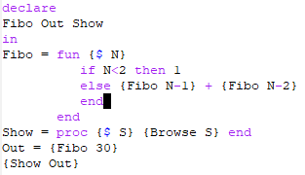
Fibonacci example (Oz)
A recursive function computing the Nth element in the Fibonacci sequence
This code showcases how functions and procedures are values in Oz, which can be stored in variables
This code makes use of the built-in function {Browse}

Slide 8
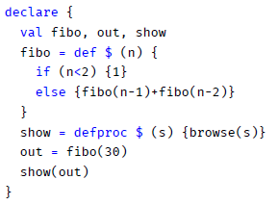
Fibonacci example (NewOz)
Values declarations are aligned with Scala
C/Java-like conditional statements
Function/procedure calls are more in par with recent languages
This code makes use of the built-in function browse()

Slide 9
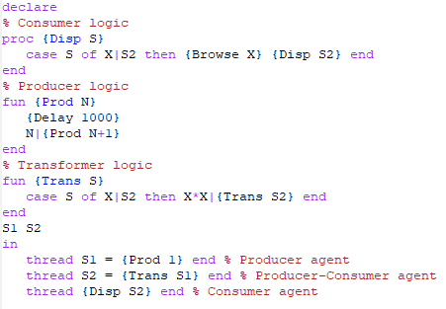
Pipeline example (Oz)
Thread-agents :
A consumer, displaying the stream
A transformer, making computations on the stream
A producer, generating the stream
All in a very compact syntax thanks to logic variables allowing data-driven computations

Slide 10
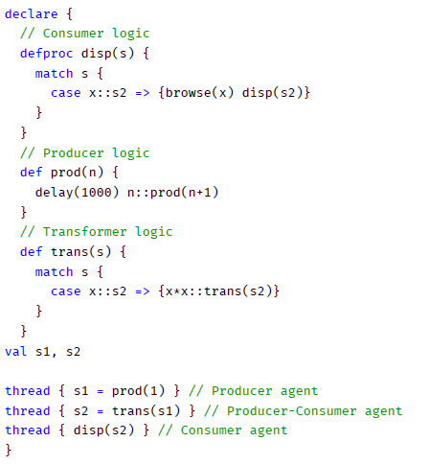
Pipeline example (NewOz)
Same 3 thread-agents :
Pattern-matching is closer to Scala and Java’s approach
Showcases the use of curly braces for scoping
Val keyword declares constant values (= Oz variables)
All in the same amount of significant SLOC

Slide 11

Creating A Full, Performant Compiler For The New Syntax
Results from this phase :
A new compiler : nozc
Written in Java 16 using modern libraries and frameworks
Focus on portability and maintainability
Fully open-source with a permissive, BSD licence – available on GitHub
A powerful CLI, with among others the ability the print the generated AST
Able to translate NewOz code to the Oz equivalent, and then run ozc depending on the command-line arguments
Includes most of Mozart’s built-in library

Slide 12

Getting an external evaluation of the syntax from users
Our feedback methodology :
By reaching out to contributors on Twitter, Alumni mailing lists and other forums
Asking them to give their opinion on the GitHub repository
Providing them with documentation on how to use the syntax and its compiler
We got mitigated results :
Limited amount of participants
Mostly “surface-level” feedback (discussion on the choice of a specific keyword, etc.)
No real discussion on “philosophical” choices

